Slide 1

Object Oriented Programming
Structural Design Patterns: Composite
IT620
Sourish Dasgupta
Assistant Professor, DA-IICT, Gandhinagar
https://daiict.ac.in/faculty/sourish-dasgupta

Slide 2
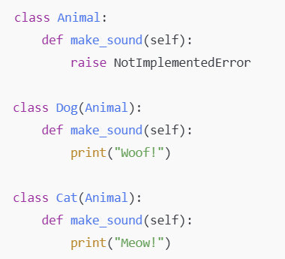
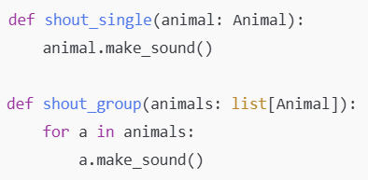
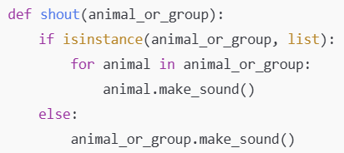
Why should we think about Composite?
What if we need two ways of making them talk - individually and as a group?
Type may change!
Code duplication!
Repetitive check, fragile!
IT620: Structural Design Patterns: Composite
Sourish Dasgupta

Slide 3
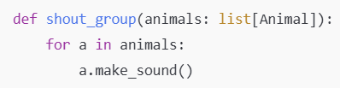
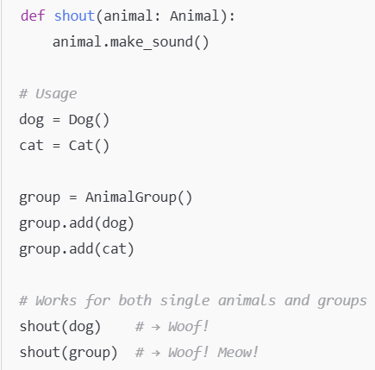
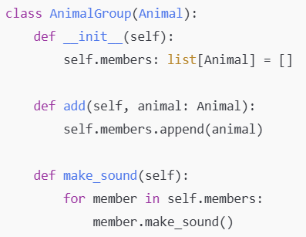
Can we treat a group (composite) as an individual?
Group as an Individual animal
IT620: Structural Design Patterns: Composite
Sourish Dasgupta

Slide 4
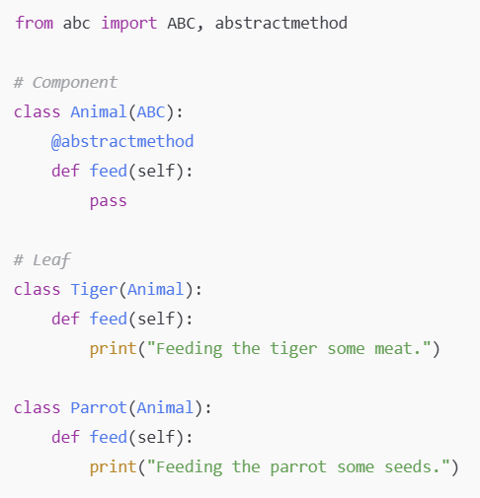
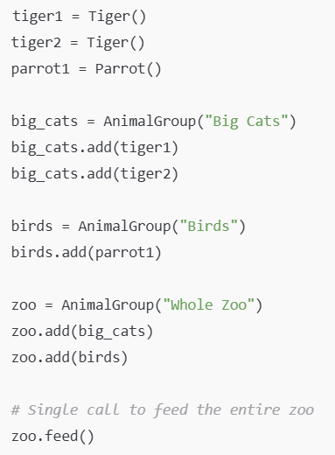
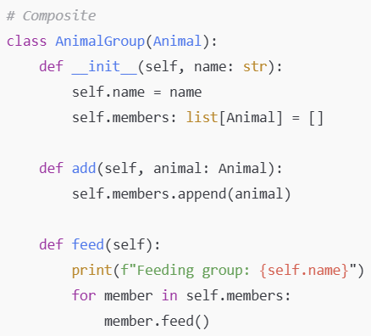
Can we make groups and then group them all? (nested)
Opens up nesting - why??
IT620: Structural Design Patterns: Composite
Sourish Dasgupta

Slide 5
So how exactly Composite Pattern is different?
Pattern | Primary Intent | Problem Solved | Key Benefit
Adapter | Convert one interface into another | Make incompatible interfaces work together | Reuse existing code without modifying it
Facade | Simplify a complex subsystem | Provide a single, easy-to-use API | Reduce coupling between clients and subsystems
Decorator | Add responsibilities dynamically | Extend object behavior without subclassing | Flexible, runtime behavior augmentation
Composite | Compose objects into tree structures | Treat individual objects and object groups uniformly | Simplify client code by handling leaf and composite nodes identically
IT620: Structural Design Patterns: Composite
Sourish Dasgupta

Slide 6
Does grouping always lead to Composite?
IT620: Structural Design Patterns: Composite
Sourish Dasgupta

